Slide 1





Notes:
Title Page
NEXT: Site

Slide 2
Core
Mindsets
Notes:
Core Mindsets
These First several refer to the foundational attitudes and beliefs that guide behavior and interactions with guests and colleagues.
These mindsets shape how hospitality professionals approach their roles, influencing everything from customer service to team dynamics.
These core mindsets are essential for creating memorable experiences, building lasting relationships, and fostering a culture of excellence in hospitality.
You have to start here first before you can be successful with any other the other rules
NEXT: #1

Slide 3
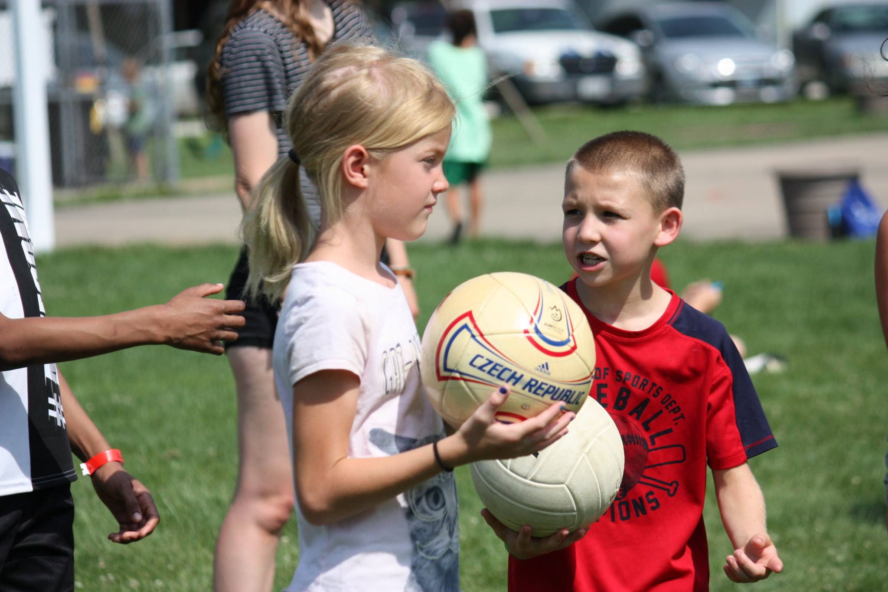

1
Customer Service is
Everyone’s Job
Notes:
1. Customer Service Is Everyone’s Job
Customer service isn’t a role – it’s a mindset. When everyone takes ownership, we create an experience where every moment is tailored, every need is met, and every person feels valued.
• Make customer service the responsibility of every employee.
• Train every staff member, from counselors to kitchen staff, to see themselves as service providers.
• Empower all team members to solve problems.
• Encourage staff to notice and act on opportunities to assist campers, even outside their assigned roles.

Slide 4
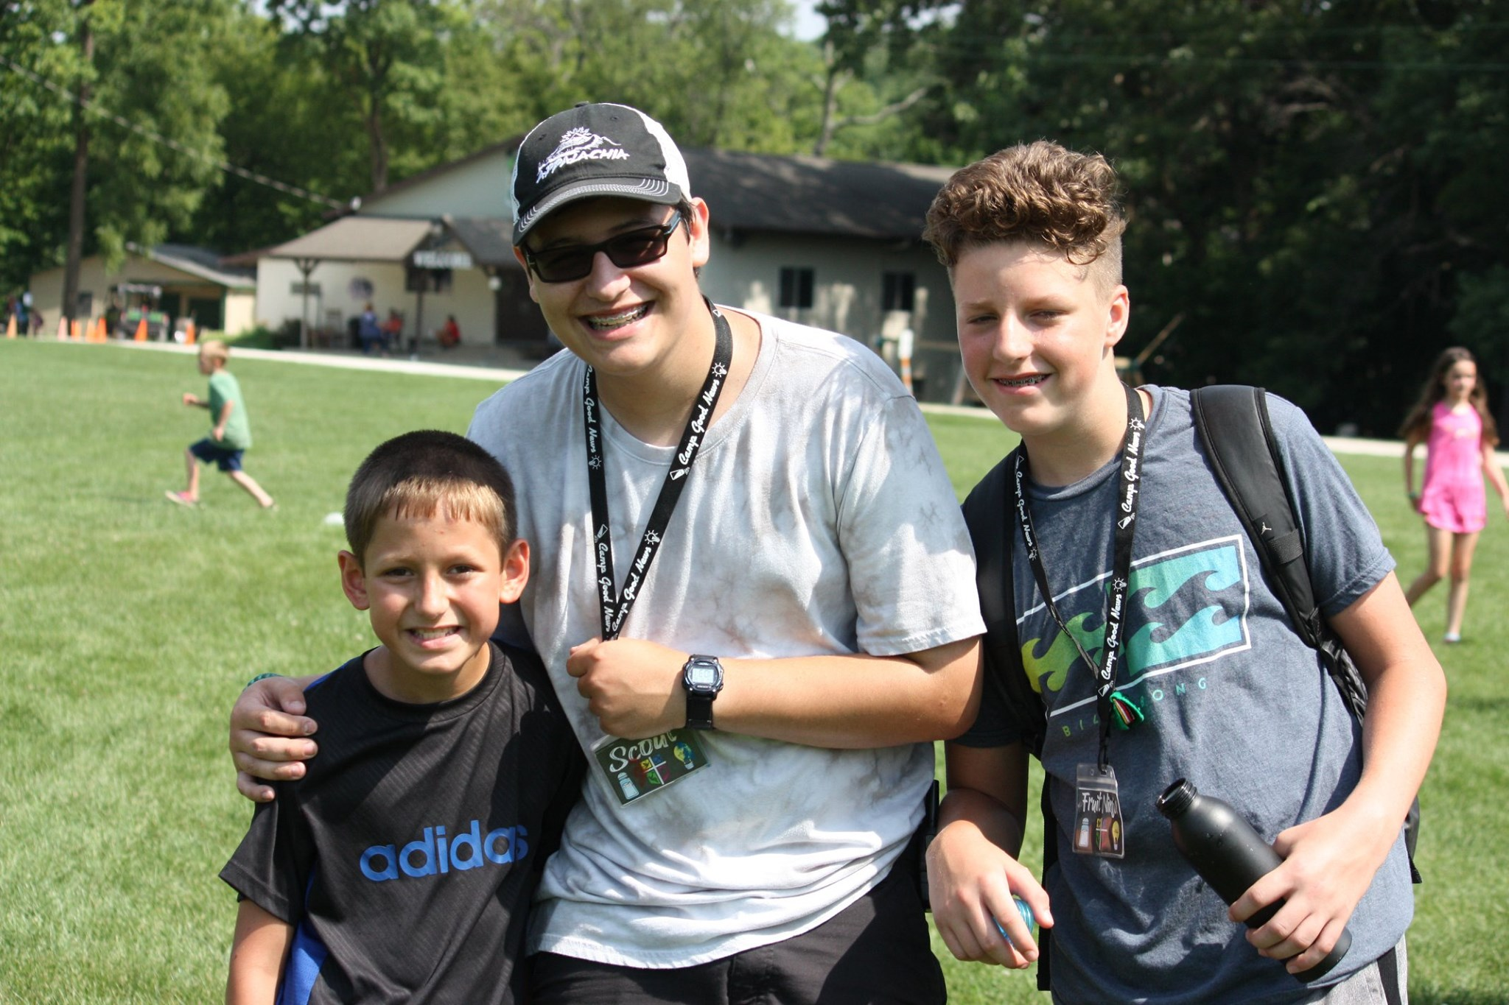

Everybody
Matters
2
Notes:
2. Everybody Matters
Every person deserves to feel seen, heard, and valued. When we make the effort to connect, understand, and respond, we don’t just meet expectations – we create lasting, meaningful experiences.
• Prioritize personal interactions with each camper and family.
• Train staff to learn and use every camper’s name within the first day.
• Train employees to recognize and respond to needs proactively.
• Follow up on concerns or complaints immediately to rebuild trust.

Slide 5
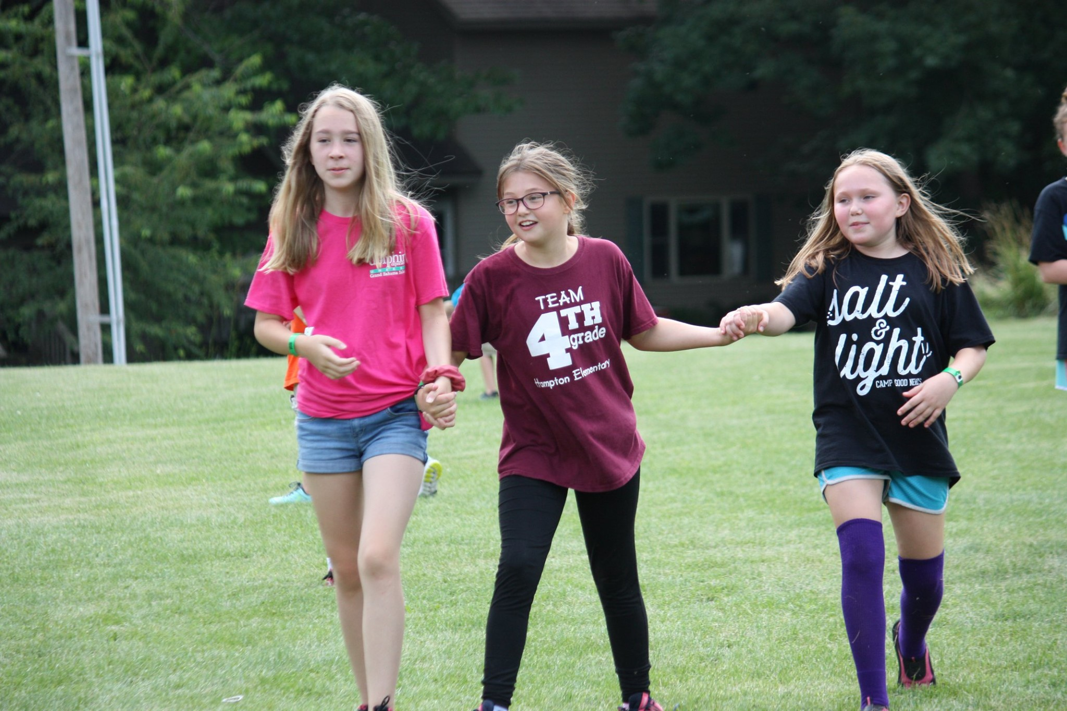
3
Serve With
Heart
Notes:
3. Serve with Heart
When we serve with warmth and empathy, we turn moments into memories
• Approach interactions with warmth and sincerity.
• Take extra care with special requests and unique needs.
• Make parents feel confident in leaving their children by providing regular updates
• Follow up after service to ensure satisfaction.
• Create personalized moments, like celebrating birthdays with a special dessert.
• Show gratitude with thank-you notes or special perks.
• Ensure campers have sunscreen, water, and proper footwear for activities.
• Double-check accommodations for dietary restrictions and special needs.
• If a camper is feeling homesick, create a special "home-away-from-home" care package. Assign staff to work with them closely and highlight their bravery during a group meeting

Slide 6
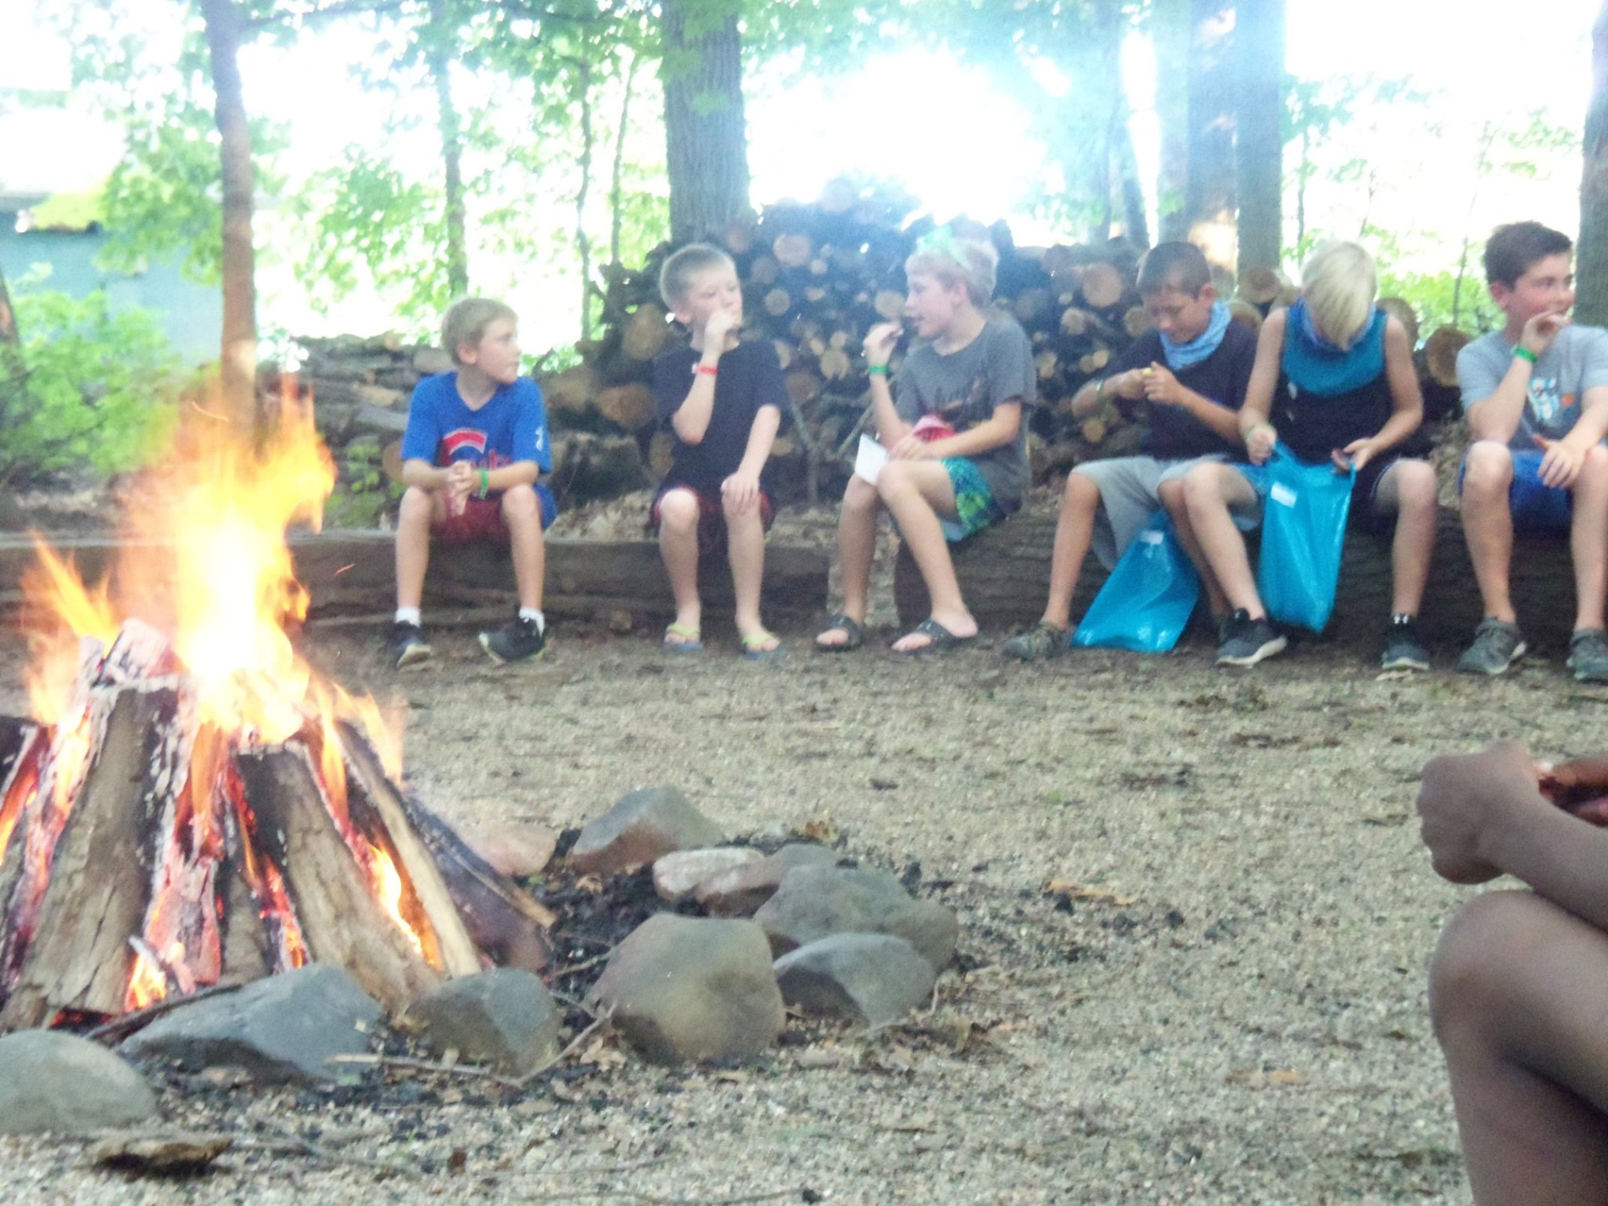
Listen
up
4
Notes:
4. Listen Up
People usually want to be heard more than they want to be agreed with.
• Actively listen to feedback, without interrupting, to identify areas for improvement.
• Actively listen to concerns and implement changes when possible.
• Show guests their input is valued by acting on it.
• Don’t make excuses.

Slide 7
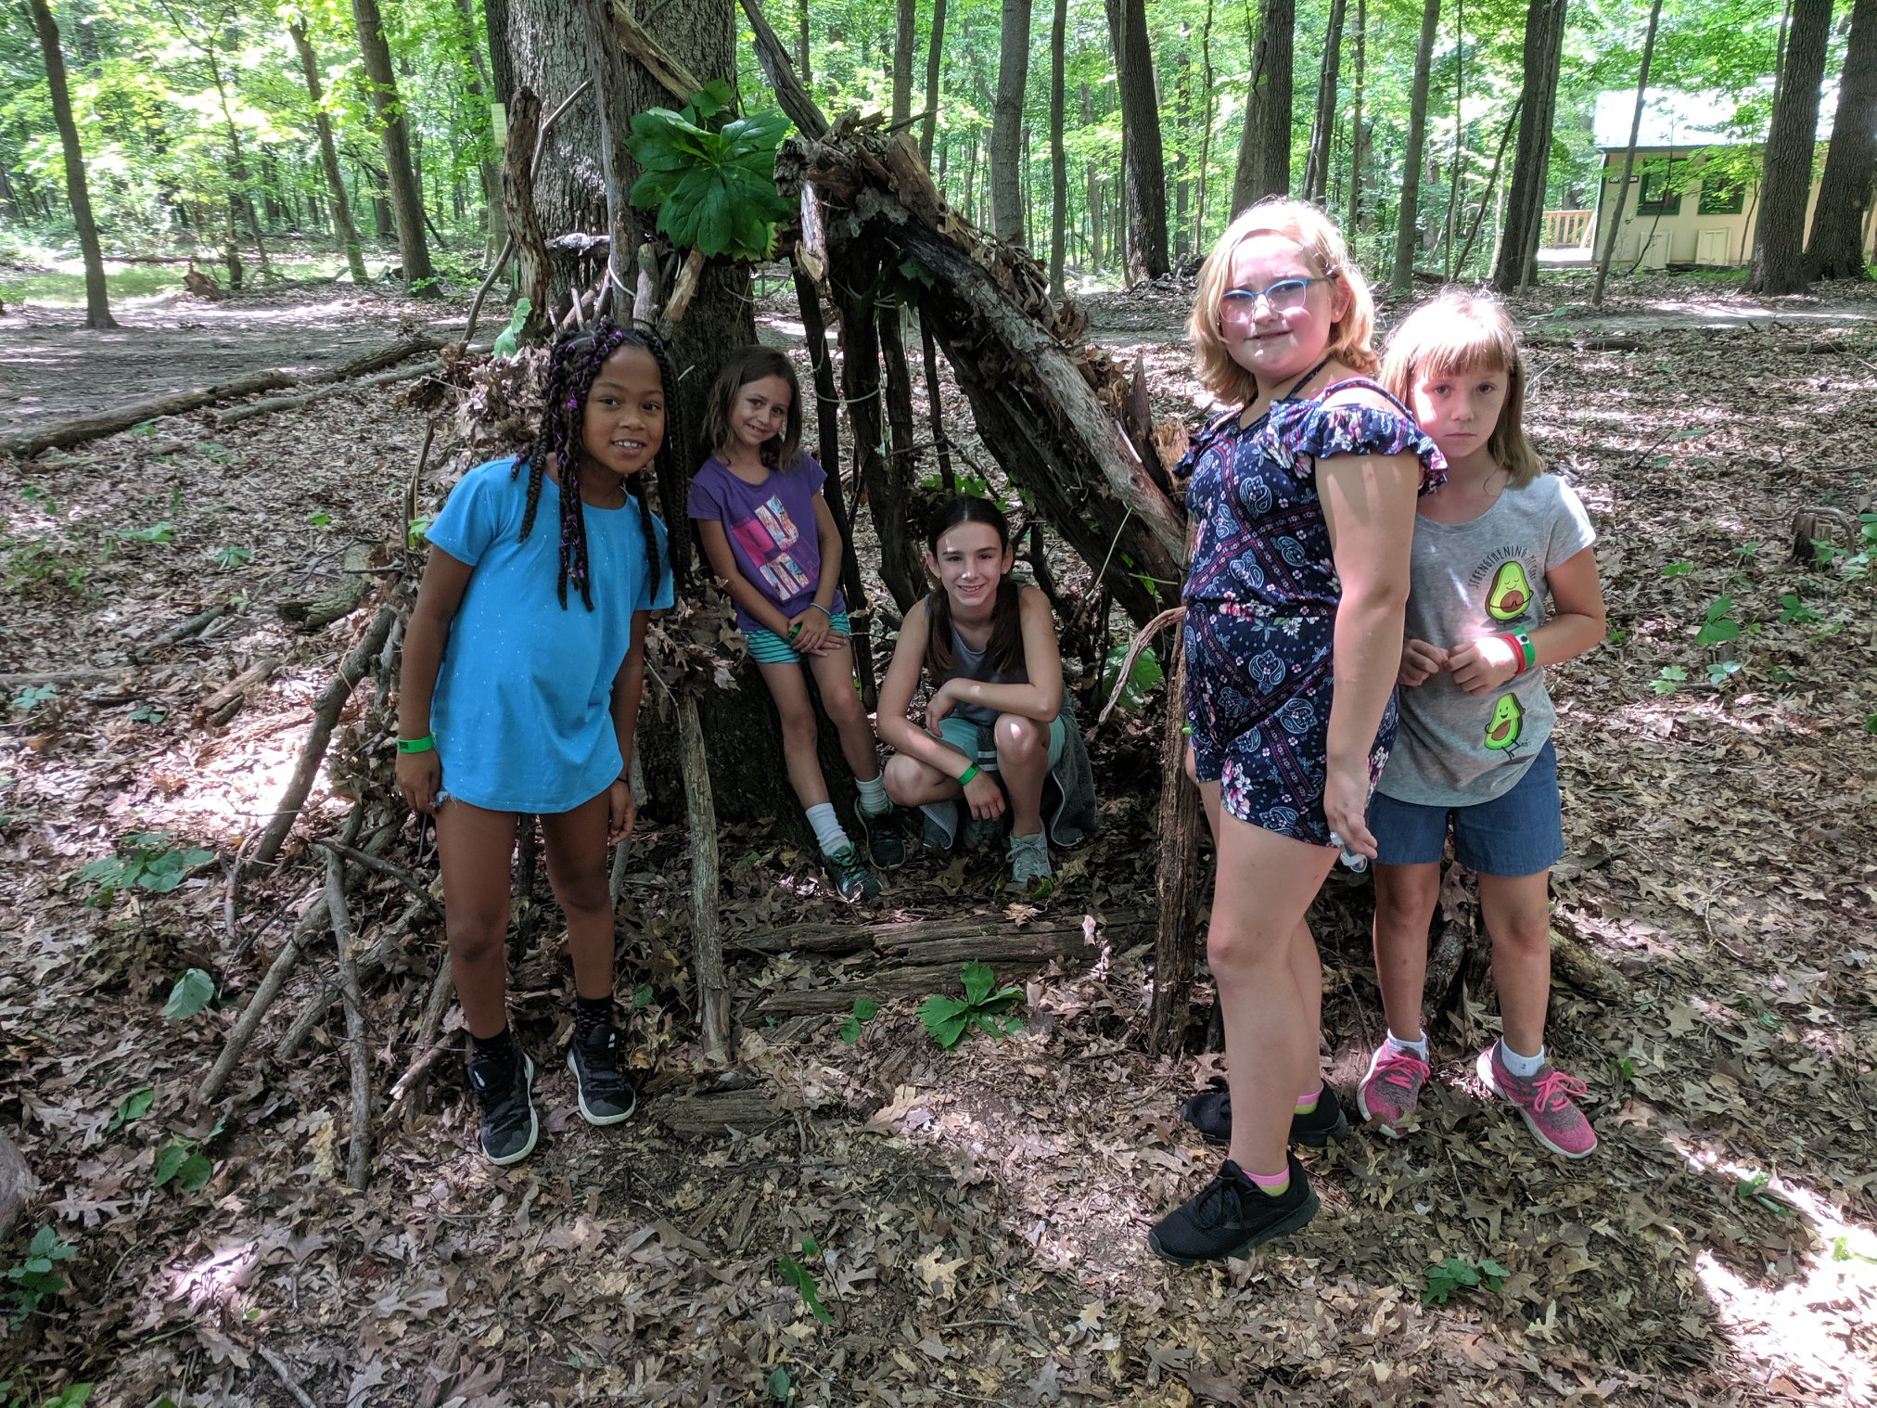

5
Choose Your
Words Wisely
Notes:
5. Choose Your Words Wisely
Kind words can be short and easy to speak, but their echoes are truly endless.
• Use positive language that emphasizes solutions.
• Encourage staff to focus on what can be done instead of what can’t.
• Train employees to communicate, clearly and respectfully, how to respond to common camper questions or concerns
• Never talk poorly about other staff, campers, groups, or competition to customers.
• Develop scripts for key moments, like welcoming campers or resolving complaints.

Slide 8
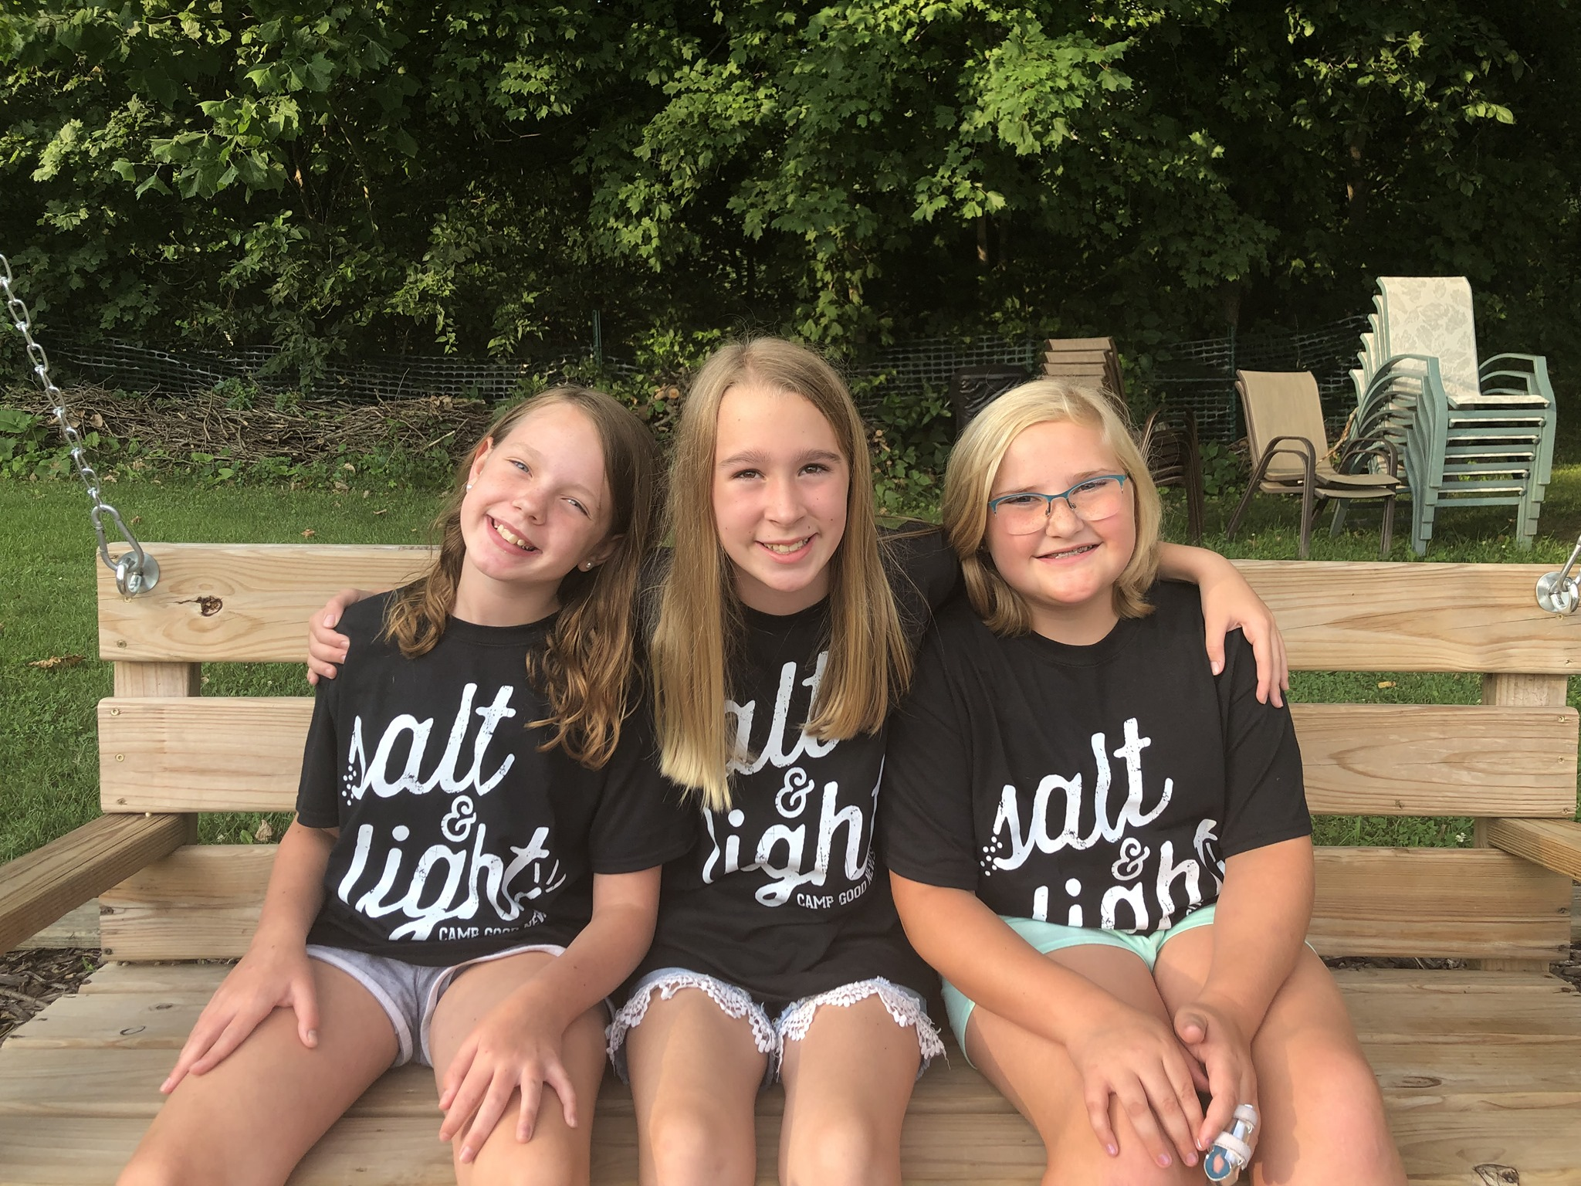
Responsibility
Take
6
for Mistakes
Notes:
6. Take Responsibility for Mistakes
Perfection as an overall goal is overwhelming and unobtainable, but we are going to get as close as we can.
• Empower staff to own up to mistakes and make things right and learn from them.
• Model accountability at all levels of the organization.
Foster a culture where problems are resolved collaboratively.

Slide 9
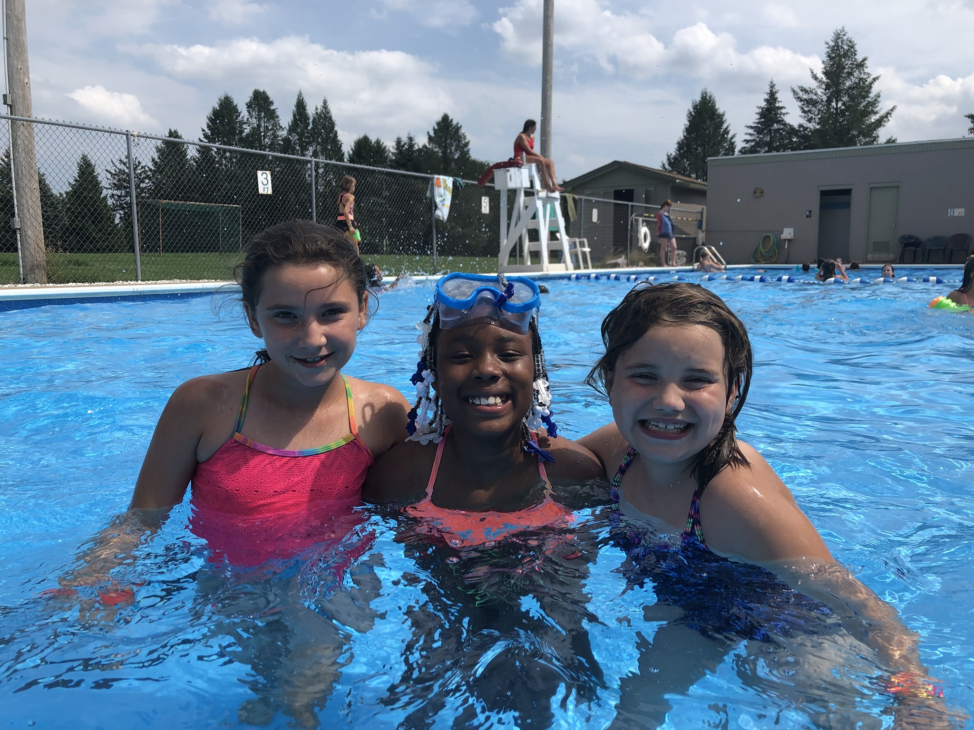
7
Love
Learn to
Complaints
Notes:
7. Learn to Love Complaints
There is a better way to do everything. There is often a brilliant idea right behind a bad one.
• View complaints as opportunities to identify and improve recurring problems
• Thank complainers for pointing out issues.
• Encourage employees to provide constructive feedback.
• Create safe spaces for voicing concerns without fear of retaliation.
Use complaints from within to identify and fix internal inefficiencies.

Slide 10
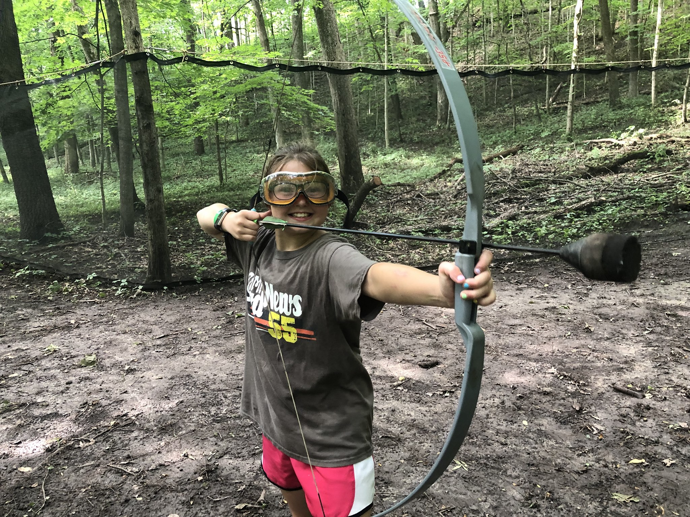
“No"
8
There is No
Notes:
8. There is No “No”
A problem is a chance for you to do your best and impress the giver of the problem
• Reframe refusals into alternatives or solutions. (like offering a different snack for dietary restrictions)
• Train employees to say, “Let me see what I can do,” instead of, “That’s not possible.”
Focus on what can be offered instead of limitations.

Slide 11
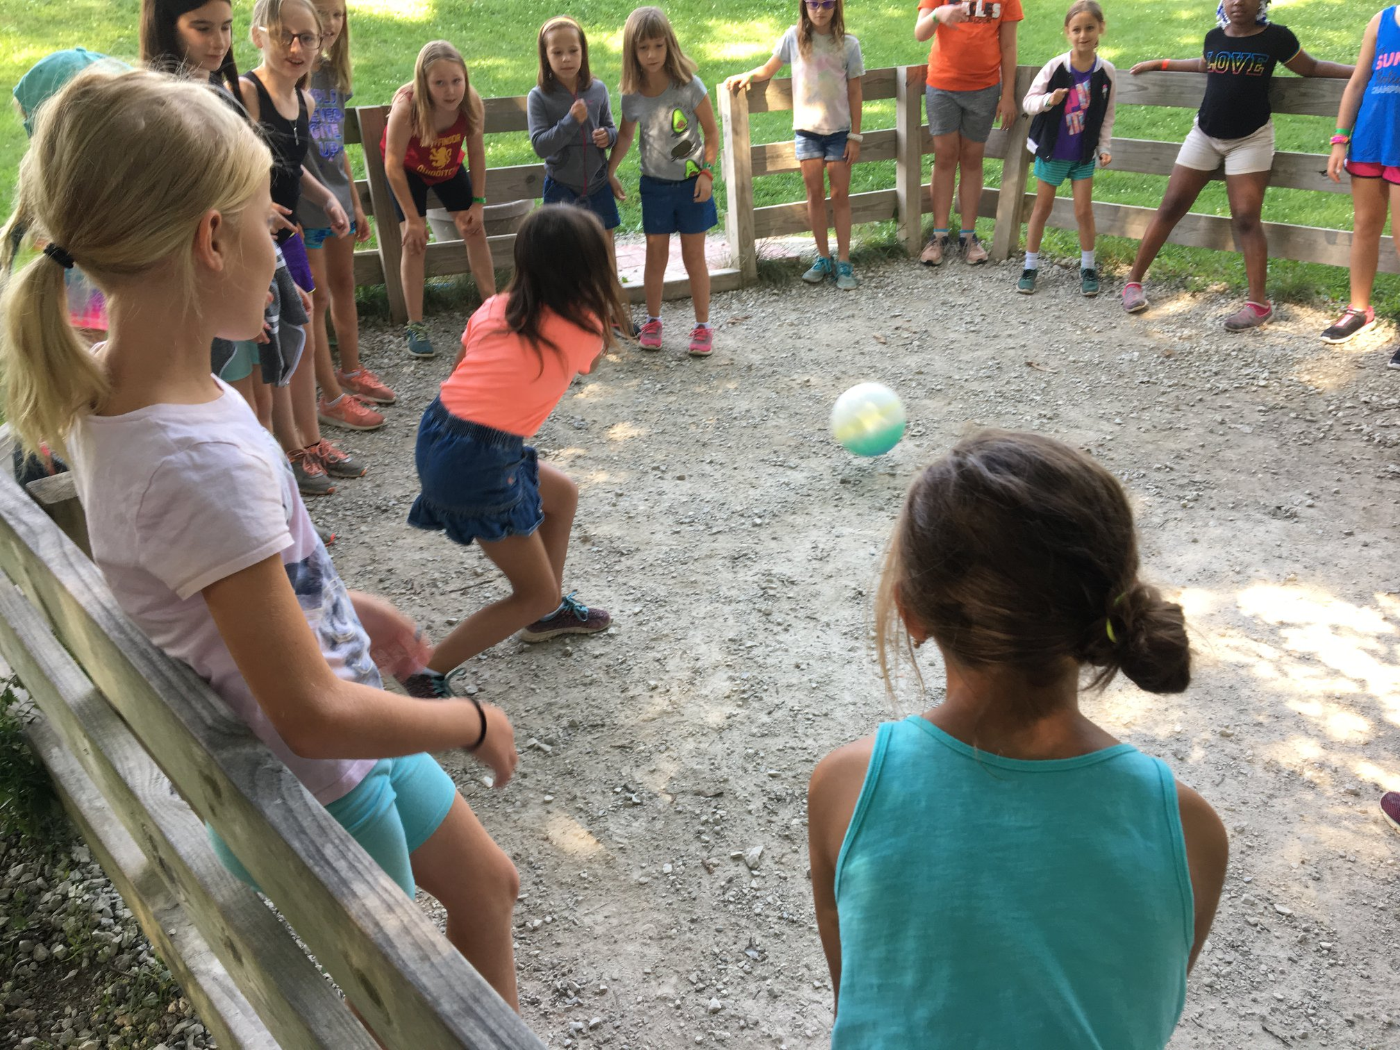
I Don’t Know
ID
Learn to say
9
But…
Notes:
9. Learn to Say “I Don’t Know, But…”
Nobody knows what they are doing before they do it.
• Teach staff to admit when they don’t have answers but promise to find solutions.
• Train staff to follow up promptly with the correct information.
• Encourage transparency to build trust.

Slide 12
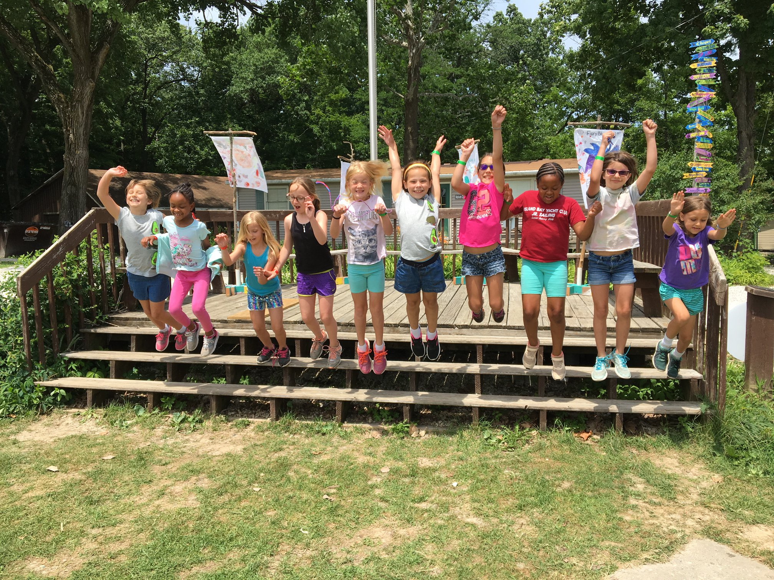
Always
Be Professional
10
Notes:
10. Always Be Professional
Excellence is not being the best, but doing your best
• Maintain a polished appearance and demeanor.
• Teach staff to stay calm, respectful, and empathetic, even when campers are upset.
• Treat every customer interaction as an opportunity to build trust.
• Encourage staff to maintain professionalism and a positive attitude, even during downtime.
• Remind staff that every interaction shapes guest’s perceptions.

Slide 13
Staff
& Facilities
Notes:
Staff & Facilities
Pretty Self explanatory here
This is the building blocks of Hospitality
Gotta start with your staff and Facilities

Slide 14
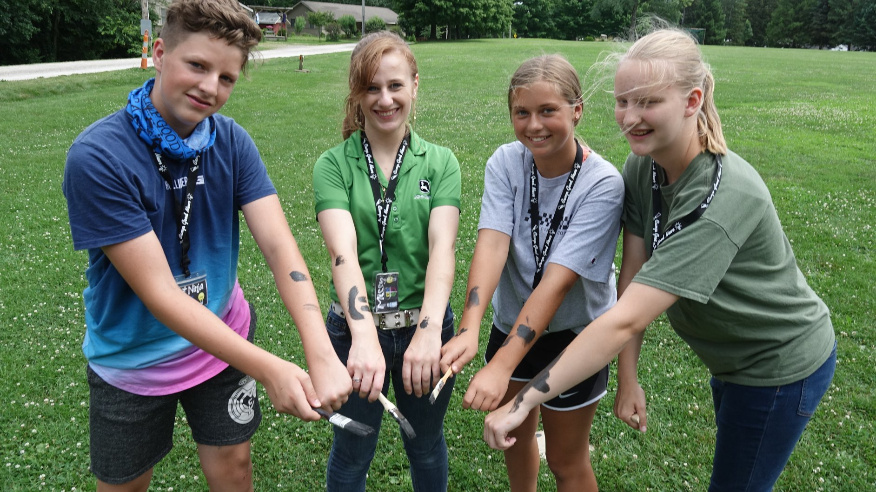
11
Best
Hire the
Notes:
11. Hire the Best
If you want to make any meaningful change, you have to surround yourself with a great team.
• Recruit counselors and staff who are enthusiastic, kind, and ministry-oriented.
• Conduct interviews that focus on candidates’ interpersonal skills and spiritual maturity.
• Invest in comprehensive onboarding programs.

Slide 15
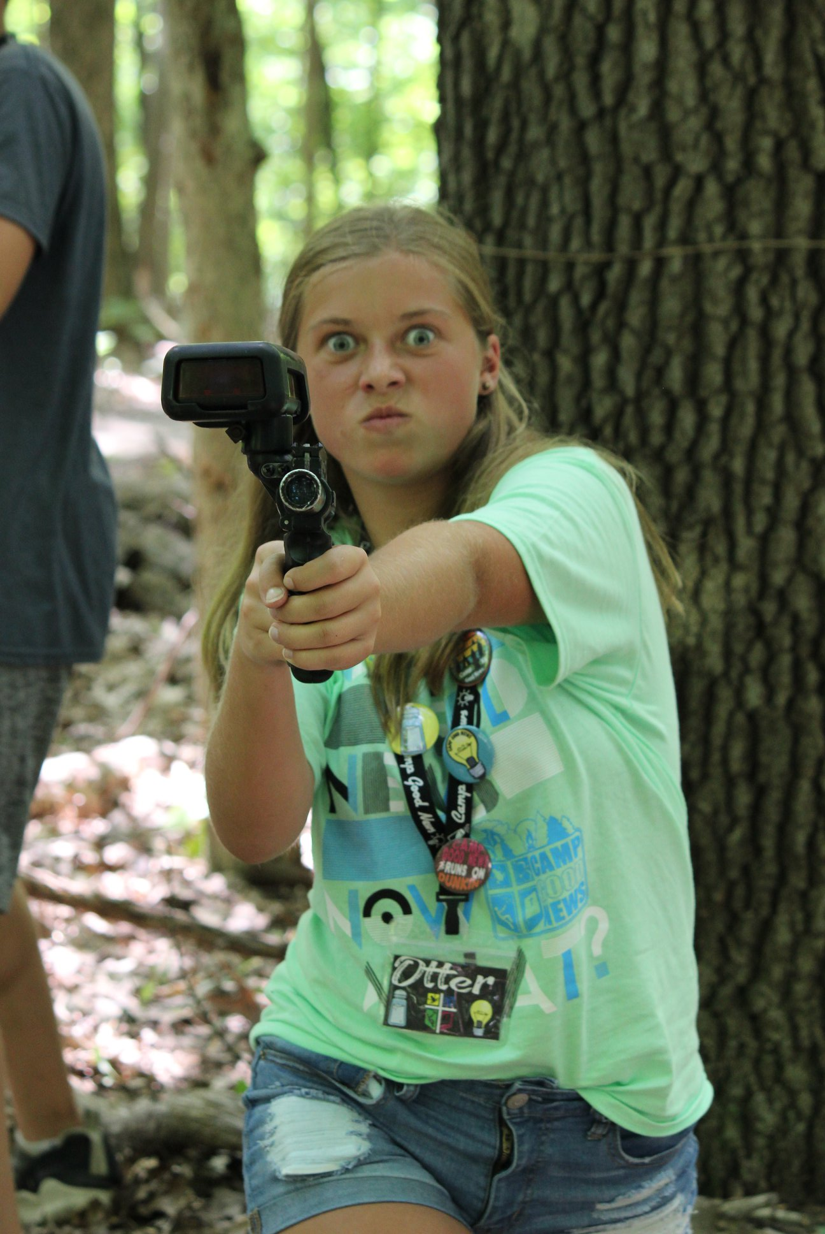
12
Lead
by Example
Notes:
12. Lead By Example
All it takes for something extraordinary to happen is one person with enthusiasm.
• Lead by example in attitude, work ethic, service mindset, kindness, patience, and enthusiasm.
• Inspire staff to adopt a service-first mindset through consistent encouragement
• Foster a culture of continuous improvement and personal growth.
• Leaders should model exceptional hospitality so counselors and staff emulate it.
• Mentor junior counselors and volunteers to build their confidence and skills.
Encourage staff to teach each other new techniques for leading activities or engaging campers.

Slide 16
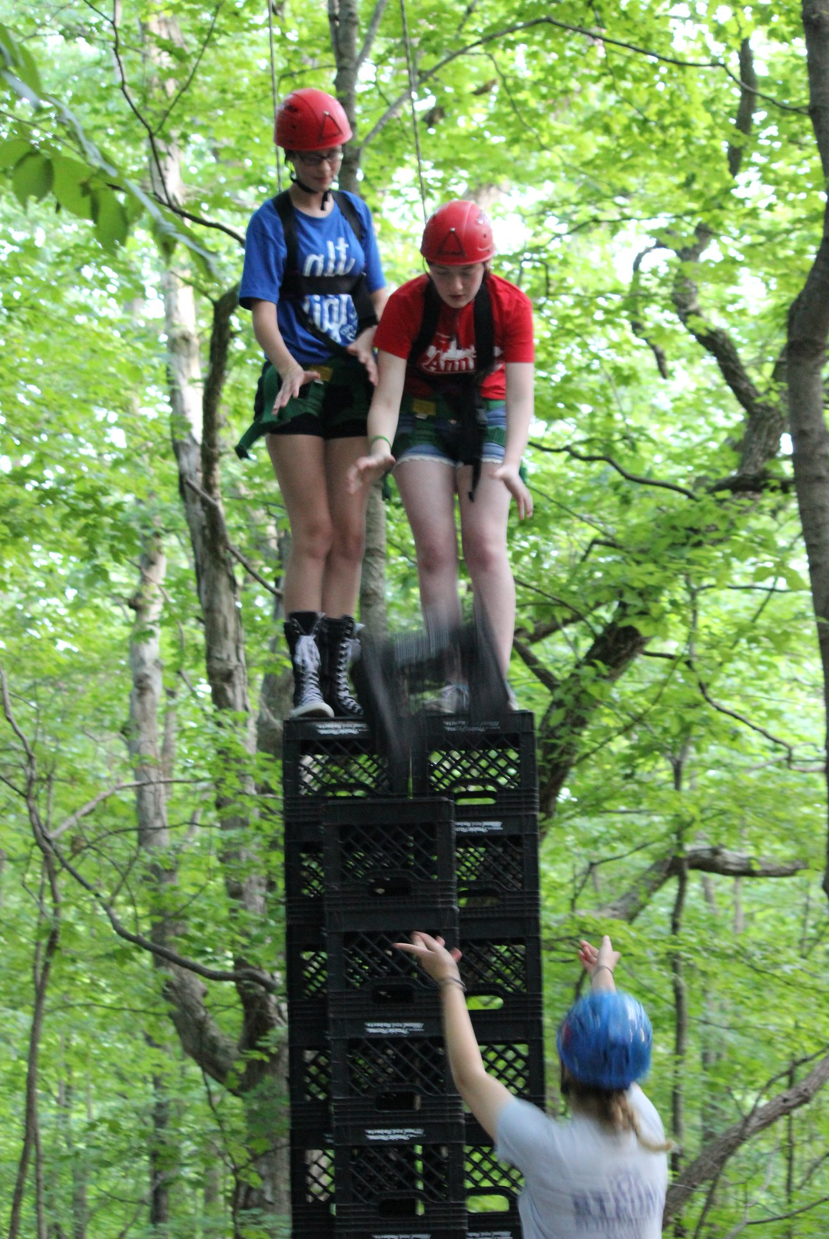
13
Bees
Be Busy
Notes:
13. Be Busy Bees
Success thrives in motion. When we work with purpose, support one another, and balance efficiency with excellence, we create a buzz that propels everyone forward together.
• Work efficiently while maintaining quality.
• Train staff to multitask effectively without compromising camper safety or experience
• Encourage cross-training to promote teamwork and versatility.
Foster a culture of mutual support and collaboration.

Slide 17
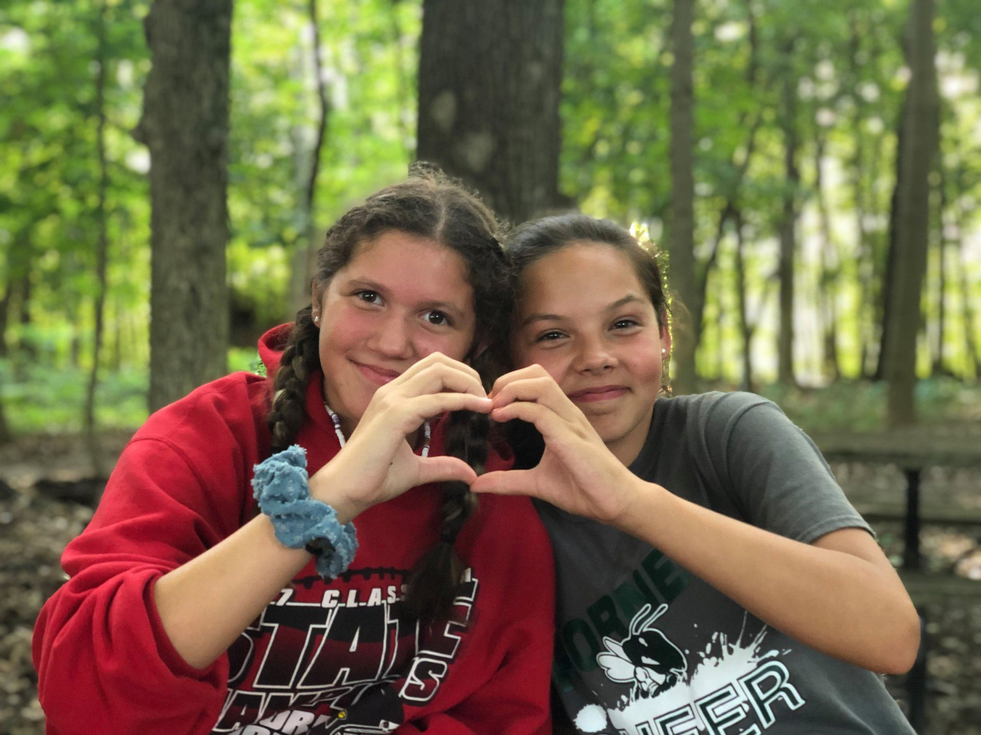
14
Make Yourself
Available
Notes:
14. Make Yourself Available
It’s not about doing more. It’s about doing more of what matters.
• Ensure leadership staff are visible and approachable for campers and parents
• Establish clear channels for communication and support.
• Offer open office hours for staff to voice ideas or concerns
• Follow through on promises and commitments.
Build trust through reliability and attention to detail.

Slide 18
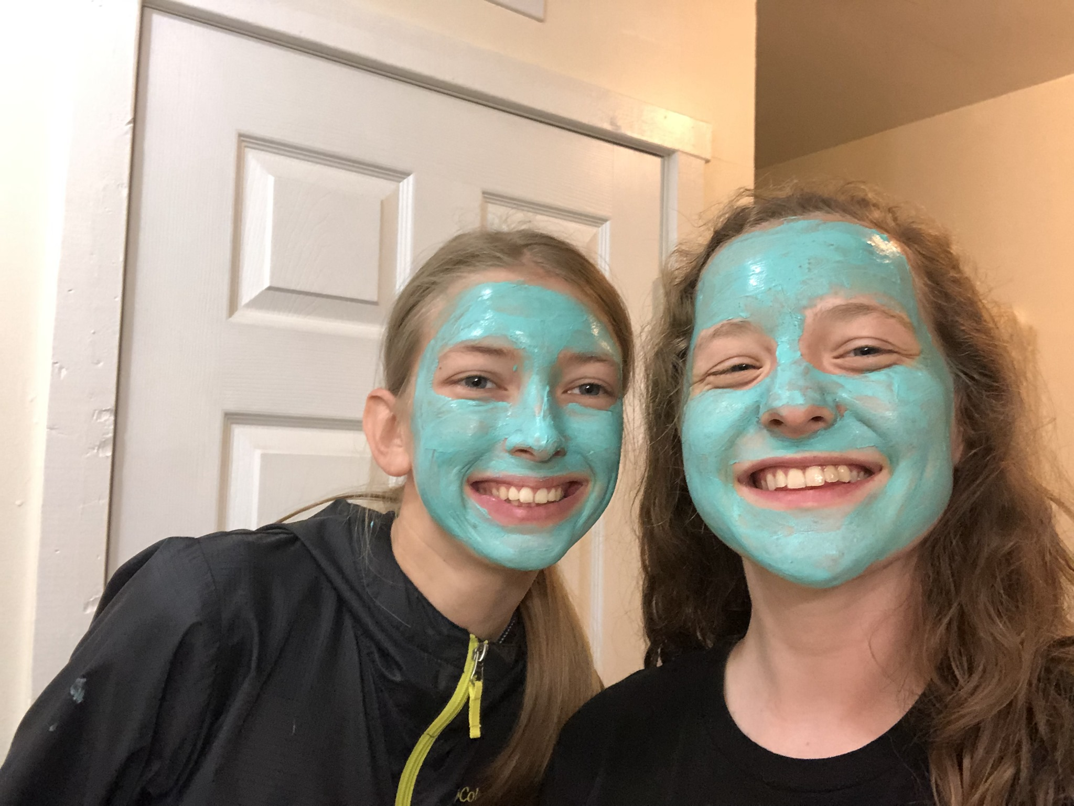
Always
Be Prepared
15
Notes:
15. Always Be Prepared
Success happens with preparation meets opportunity
• Anticipate needs before they are expressed, like having extra towels near the lake or a cooler of water at the trailhead.
• Prep activities for various scenarios to avoid last-minute scrambling.
• Be prepared with solutions for common challenges.
Monitor feedback to identify emerging trends.

Slide 19
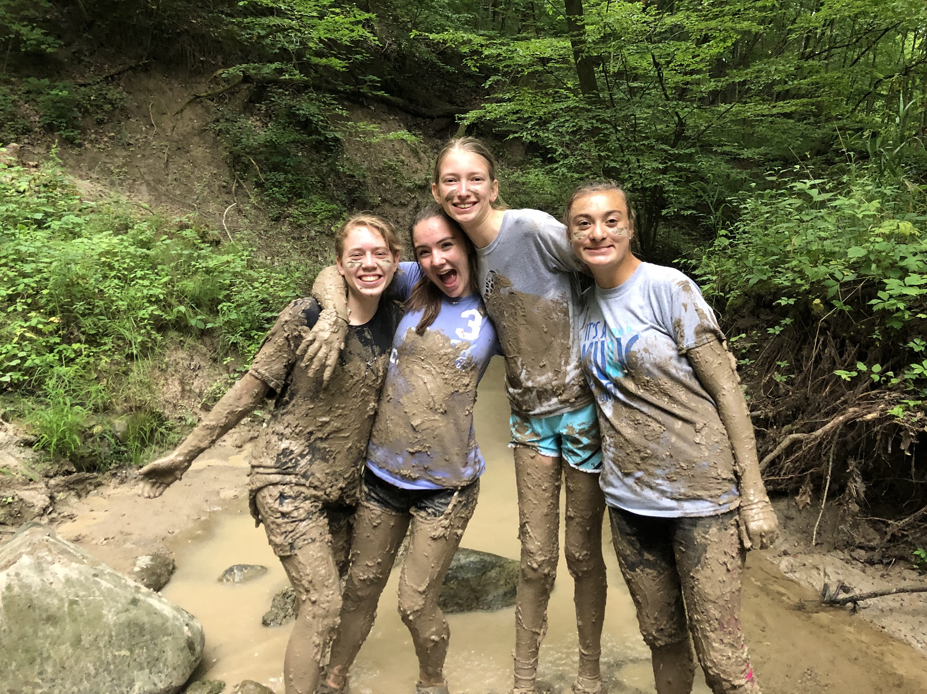
16
Master the
Basics
Notes:
16. Master the Basics
Every interaction—no matter how small—has the potential to leave a positive impression. Even routine moments, like greetings or farewells, can be transformed into extraordinary acts of care and service with intentionality. Every interaction is an investment into the future of the ministry and can impact one's decision to come back
• Reinforce the fundamentals of good service regularly.
• Reinforce basics like smiling, eye contact, and genuine greetings at staff meetings
• Simplify processes to make basic tasks easier to execute.
• Streamline check-ins and activity sign-ups to reduce wait times.
Provide clear instructions and schedules to avoid confusion.

Slide 20
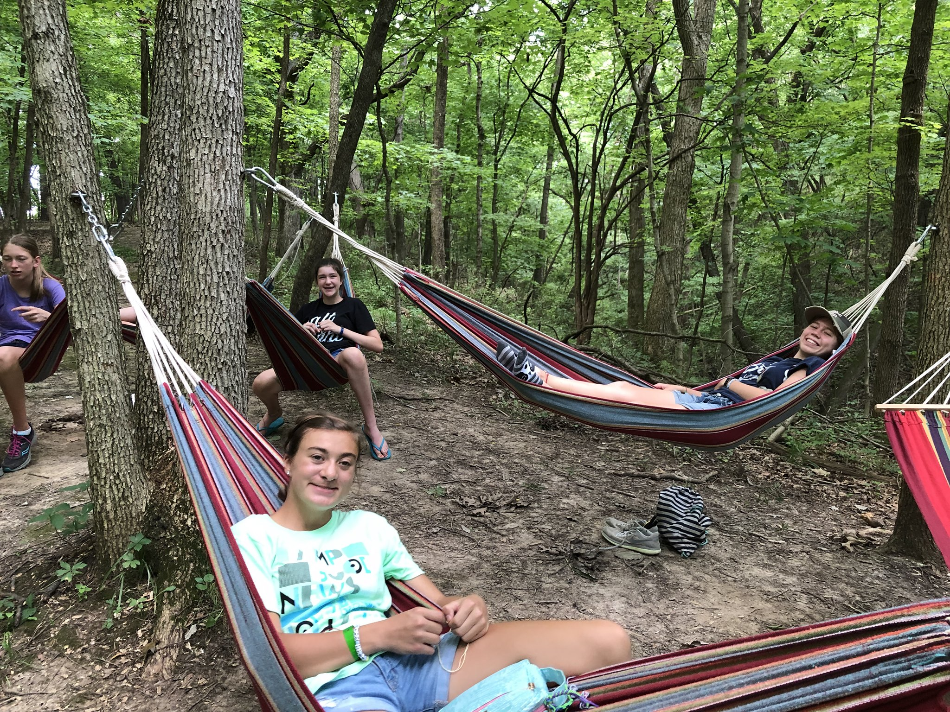
17
Keep Your
Focus
Notes:
17. Keep Your Focus
Mastery lies in the moment. When we focus fully on the task at hand, we elevate every interaction, turning ordinary into extraordinary.
• Train employees to stay present and attentive during interactions.
• Limit distractions that might affect service quality.
Encourage mindfulness and concentration.

Slide 21
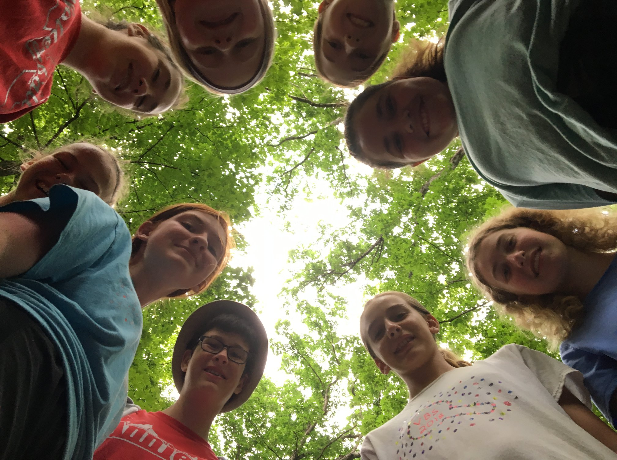
Aesthetics are
18
Super
Important
Notes:
18. Aesthetics are Super Important
First impressions are shaped by the eye, and excellence is revealed in the details. A clean, polished environment speaks louder than words, setting the tone for an unforgettable experience.
• Ensure facilities appear clean and well-maintained.
• Conduct daily inspections of cabins, dining areas, and restrooms to ensure they’re spotless.
• Provide matching camp shirts to ensure a polished appearance.
• Clean up project messes from guest’s view

Slide 22
Best
Practices
Notes:
Best Practices
These are the proven methods, strategies, and standards that lead to consistently high-quality guest experiences.
They are developed through experience, industry benchmarks, and continuous improvement.
By following Best Practices, hospitality teams create a reliable and exceptional service environment that enhances guest experiences and business success.

Slide 23
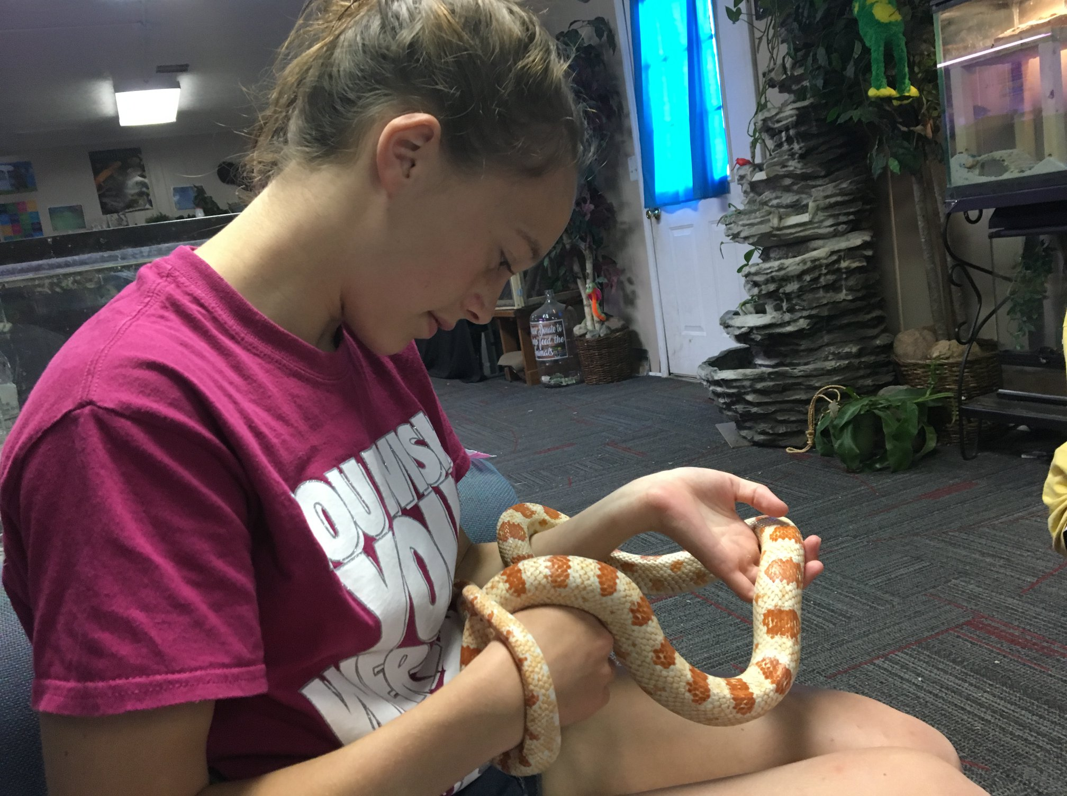
Steal
Great Ideas
19
Notes:
19. Steal Great Ideas
Creativity is thinking up brand new ideas. Innovation is taking old ideas and doing them better
• Learn from other successful camps or ministries and adapt their best practices.
• Encourage staff to share ideas they’ve seen work elsewhere.
Stay informed about trends.

Slide 24
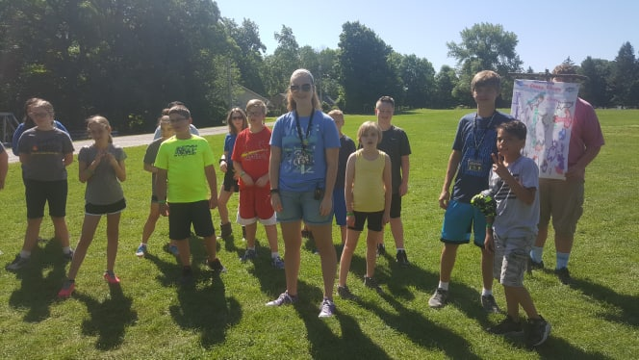
Solve Problems
20
Immediately
Notes:
20. Solve Problems Immediately
So much of leadership is being able to solve problems with efficiency and effectiveness. If you aspire to lead, in any capacity, learn to solve problems. Our common experience is that problems tend to arise daily. Leading to prevent them is highly advisable but not always attainable. Developing leaders who can find solutions will always lead to profitability, encourage creativity, and promote quality
• Empower staff to resolve issues immediately. (like replacing a broken flashlight or correcting a meal order)
• Apologize sincerely and take responsibility for mistakes.
• Follow up to ensure guests are satisfied with resolutions.

Slide 25
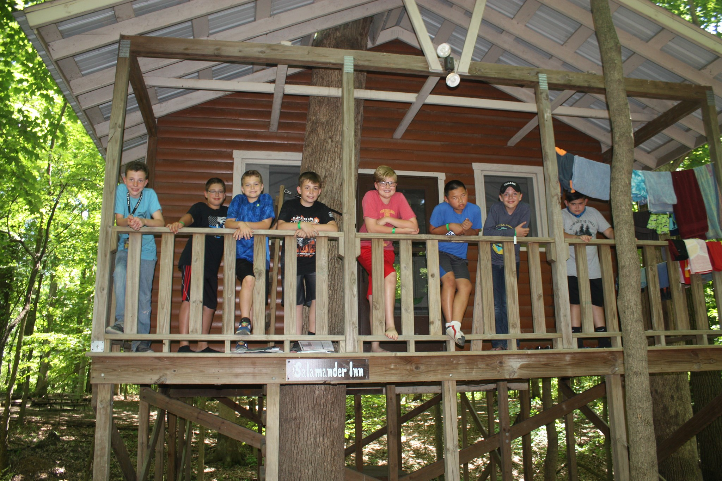
Don’t Make
21
Promises
You Can’t Keep
Notes:
21. Don’t Make Promises You Can’t Keep
Trust is built on keeping promises, not making them lightly. It’s better to under promise and over deliver than to risk disappointing those who rely on you.
• Set realistic expectations during interactions.
• Communicate delays or changes transparently and promptly.
• If an activity is canceled, offer an equally exciting alternative
• Make commitments carefully and honor them consistently.

Slide 26
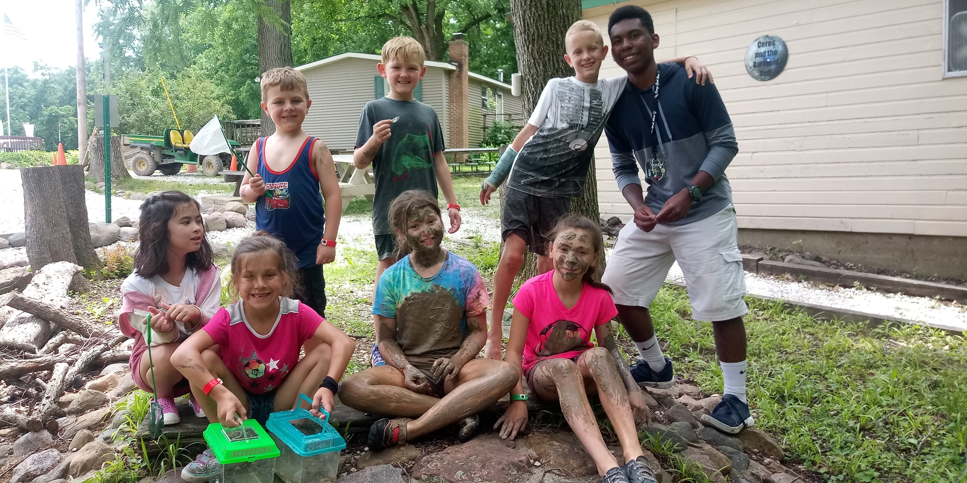
22
Give
Warm
Welcomes
Notes:
22. Give Warm Welcomes
People will forget what you do, they’ll forget what you said, but they’ll never forget how you made them feel.
• Make it a camp policy to greet every camper and parent with a warm smile.
• Make first impressions a priority during customer interactions.
• Teach staff the impact of positive body language.
• Reward staff who consistently exude warmth and friendliness.

Slide 27
Wow
The
Factor
Notes:
The Wow Factor
This refers to the extra level of service, attention, or surprise that exceeds guest expectations and creates a memorable experience.
It’s about delivering moments that leave a lasting impression, making guests feel valued and eager to return.
When hospitality teams focus on The Wow Factor, they turn ordinary interactions into unforgettable experiences that build guest loyalty and positive word-of-mouth.

Slide 28
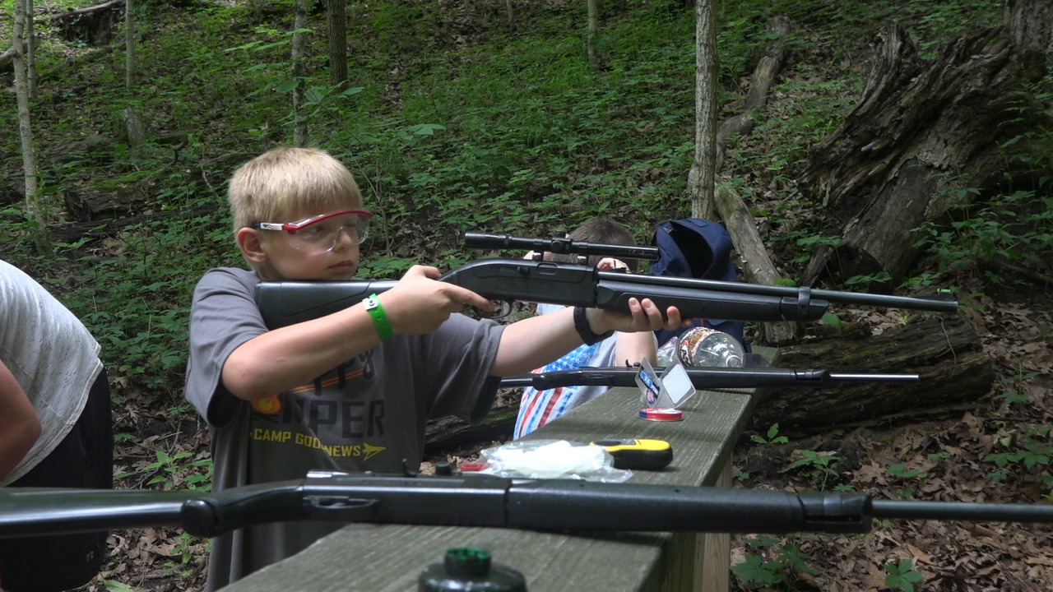
Improvement
Never Stops
23
Notes:
23. Improvement Never Stops
True growth comes not from reaching a destination, but from the constant pursuit of better. Every step forward is an opportunity to refine, innovate, and listen – because improvement never stops, and neither should we.
• Continuously refine processes and procedures.
• Encourage innovation and experimentation among staff.
• Host regular staff meetings to brainstorm ways to improve the camper experience.
• Solicit regular feedback to identify improvement opportunities.

Slide 29
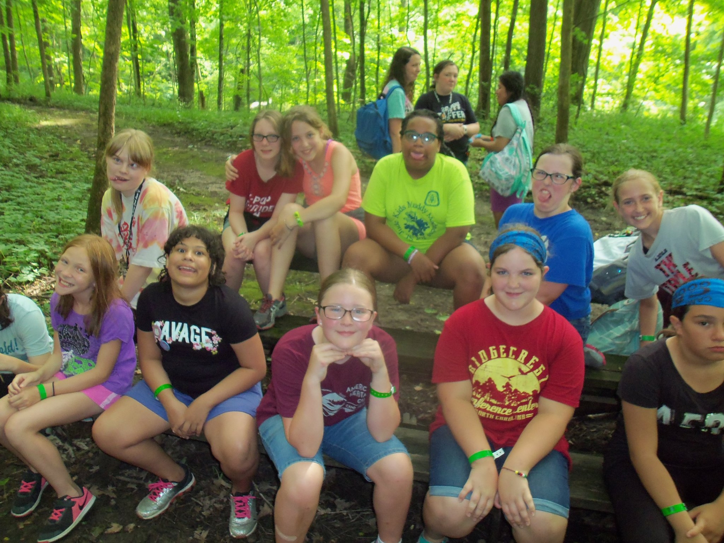
24
Fun
Make Camp
Notes:
24. Make Camp Fun
Fun is the spark that turns an experience into a memory. When we embrace creativity, laughter, and play, we infuse joy into every moment and make every interaction unforgettable.
• Infuse humor and playfulness into the camp experience.
• Encourage staff to create joyful moments for guests.
• Use themed events or creative promotions to engage and delight.
• Gamify tasks, like creating friendly competitions for the cleanest cabin or most engaged activity leader.
• Set up photo-worthy moments. Design spaces or items that encourage guests to take photos.
• Celebrate small wins with rewards or recognition.

Slide 30
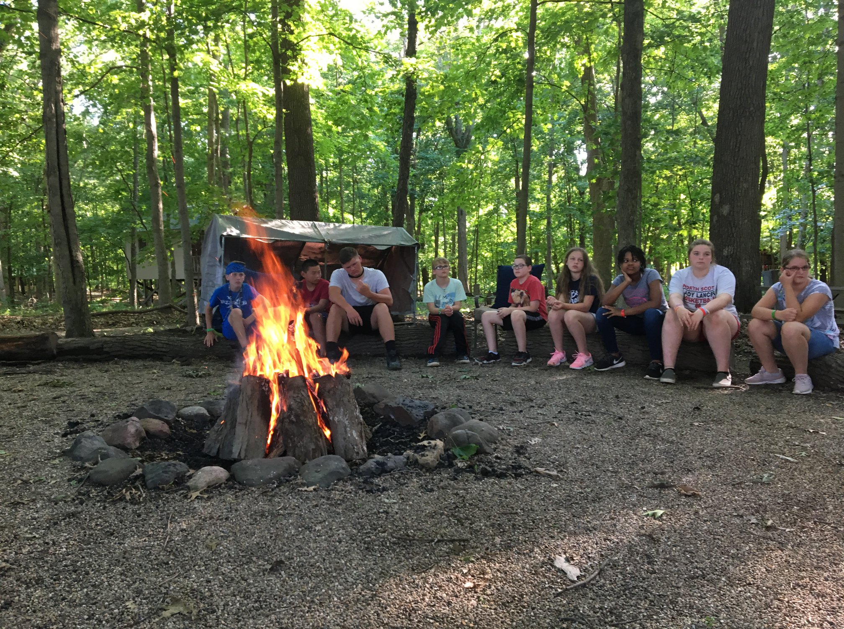
Give People a
25
Reason
to Come Back
Notes:
25. Give People a Reason to Come Back
Creating memories worth revisiting is the heart of lasting connections. When we serve the right way, we give people a reason to return – not just once, but year after year.
• Exceed expectations to create memorable experiences.
• Create annual traditions or events campers will want to return for every year.
• Regularly thank and acknowledge repeat customers.
• Write personalized thank-you notes. Reference specific moments from the interaction. Handwrite the note for authenticity
• Build strong relationships with local suppliers by treating them with kindness and respect.
• Invite vendors to camp events as a thank-you.

Slide 31
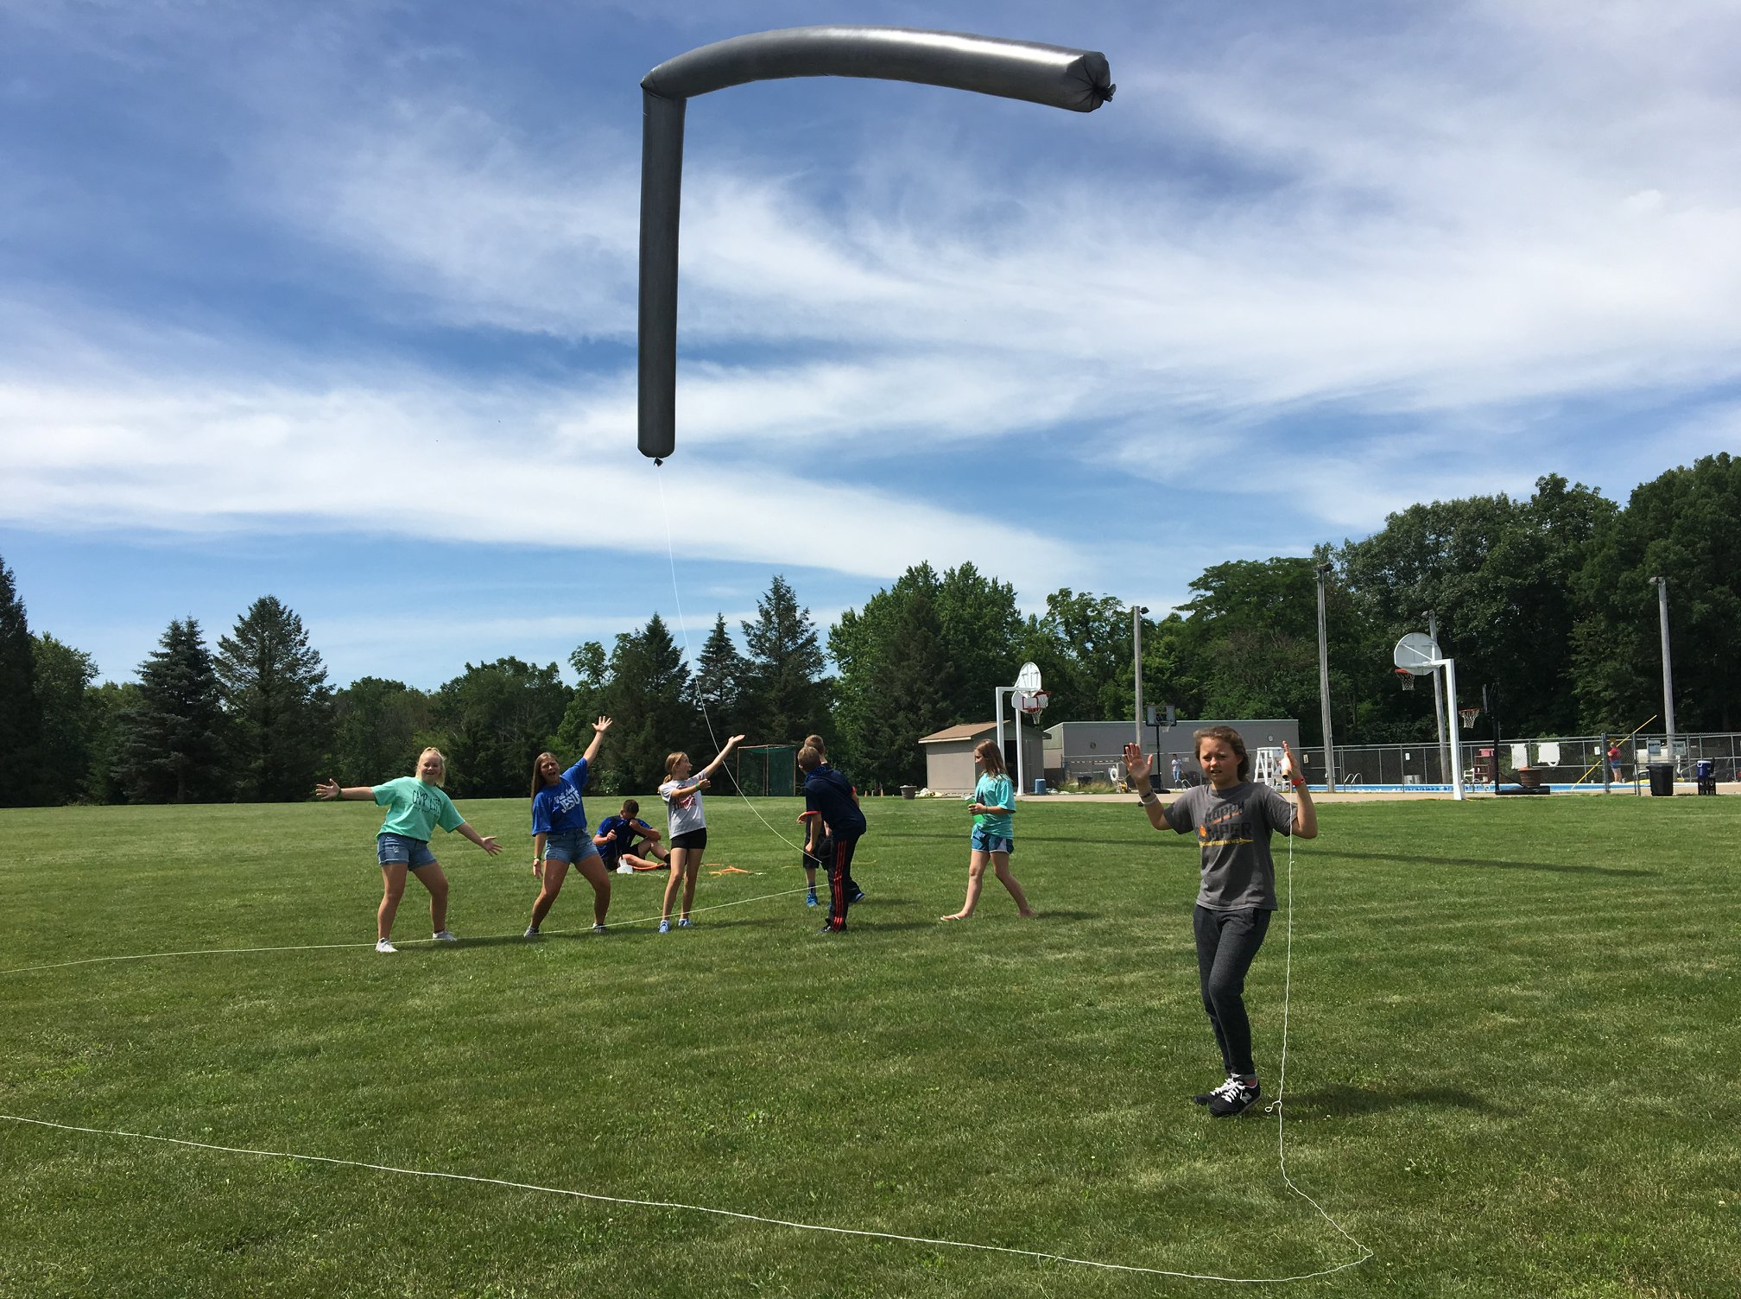
Go
Above
Beyond
26
&
Notes:
26. Go Above and Beyond
We have an opportunity, a responsibility, to make magic in a world that desperately needs more of it.
- Class called 25 rules, and you get an extra one!
• Surprise campers and guests with thoughtful gestures or perks. (Impromptu treats, like popsicles on a hot day, a late-night snack, or campfire treat delivered to their bunks. Include small surprises in their daily schedules, like a spontaneous group hike or water balloon fight)
• Offer complimentary add-ons.
• Look for small, low-cost ways to make experiences extraordinary.
• Train staff to identify moments where they can go above and beyond.
• Provide your team with a budget or flexibility to go above and beyond.

Slide 32
Key
Questions
Notes:
Key Questions to Ask
Take some time with your group to answer these questions honestly:
• How do we define true hospitality, and how does it differ from just meeting expectations?
• How do we ensure that every guest feels heard, understood, and valued during their time with us?
• What small gestures or actions can create a lasting positive impact on a camper or guest’s experience?
• How do we make them feel part of something bigger than themselves?
• At what point do we need to trade some control in favor of trusting the campers and guests?
• Does a rule bring us closer to our ultimate goal, connecting with people, or does it take us further from the goal?
• Can you think of a time when we went out of your way to make someone feel welcome? What did we do?
• In what ways can we empower our staff to make decisions that enhance the guest experience without needing constant approval
• How can we ensure consistency in delivering exceptional hospitality, even when facing challenges or busy times?
• What does hospitality look like when things don't go as planned, and how do we turn challenges into opportunities?
• What are 5 things we can do today to make our guests feel a sense of belonging the moment they arrive?
• Are there any groups we need to recover and rebuild trust with. How can we do that with them?
NEXT: TITLE PAGE

Slide 33
Notes:
Title Page
NEXT: BLANK

